Slide 1

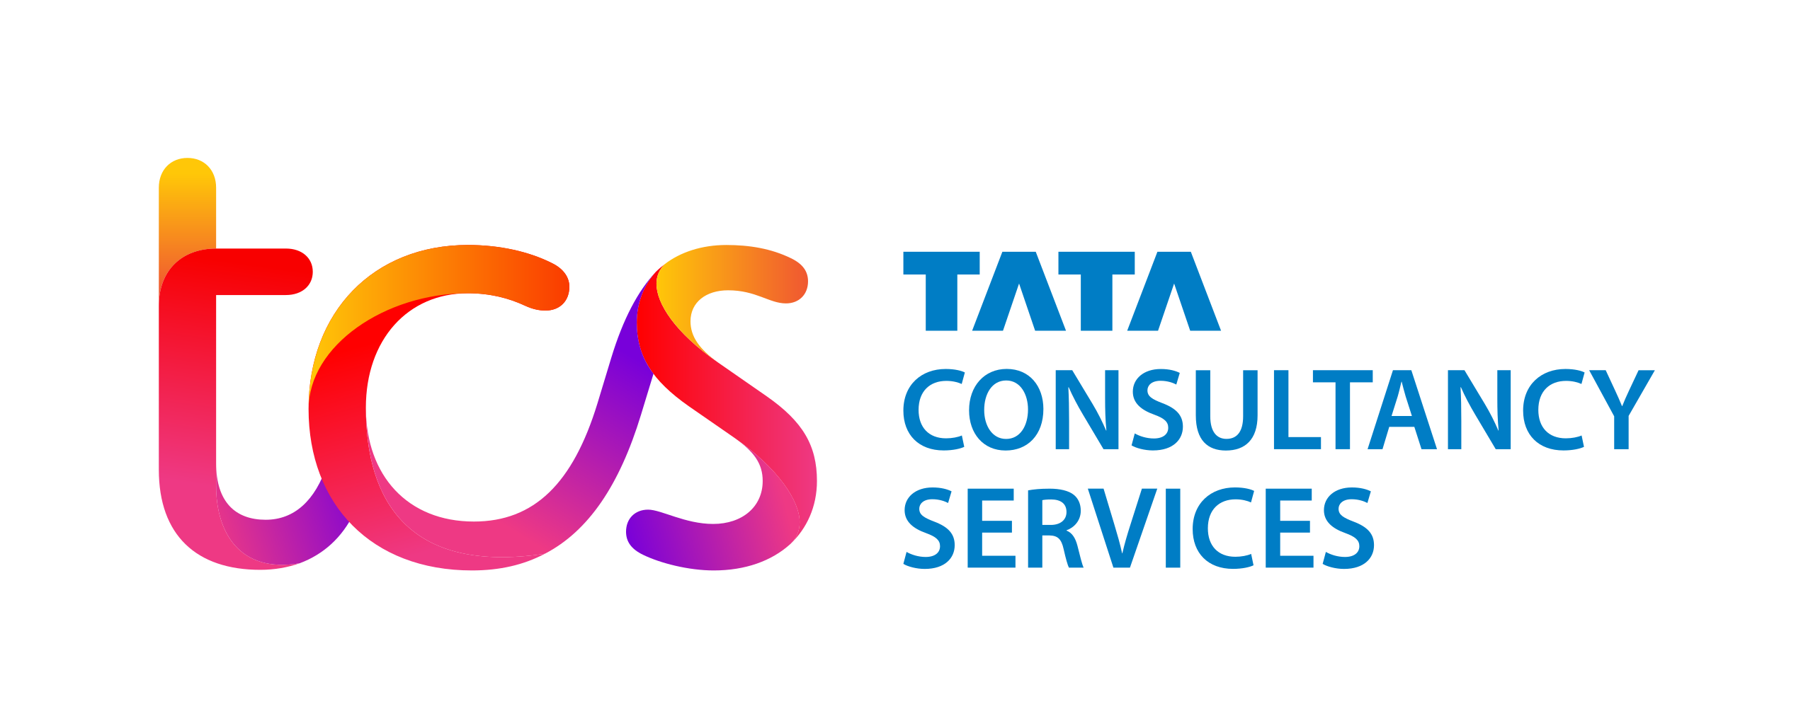

Science Foundation Ireland Centre for Research Training in Foundations of Data Science
Top Solutions and Gaps for Kaggle LLM Science Exam Competition
Mirza Akhi Khatun
Supervisors: Deepanand Saha Roy, Sreekanth Palagiri, Krishna Hariramani, Ersi Ni

Slide 2

Team H2O LLM Studio (1st Place Solution)
Method:
Utilized a combination of various language models including OpenAI's GPT-4 to achieve the highest accuracy.
Employed techniques such as fine-tuning pre-trained models on specific domains and ensembling multiple models to improve performance.
For example, the use of RoBERTa and DeBERTa v3 models
Leveraged data augmentation and preprocessing strategies to enhance the quality and quantity of training data.
Applied advanced hyperparameter tuning and optimization methods to find the best configurations for the models.
For example: Grid Search and Random Search, Optuna, Early Stopping
Hardware Used:
High-performance GPUs were used to train and fine-tune the models, likely including NVIDIA A100s or V100s.
Leveraged cloud-based solutions to access the necessary computational resources for large-scale model training.
Accuracy: 93.32% (Single Model), 93.33% (Winning Kernel)
Source: https://hippocampus-garden.com/kaggle_llm/
https://www.kaggle.com/code/ybabakhin/1st-place-team-h2o-llm-studio

Slide 3
Gaps in Our Implementation
Model Complexity: The top solutions used more complex models and techniques, including ensembling multiple models, which we did not have implement.
Data Augmentation: Effective data augmentation strategies were employed to improve model robustness, which is missing in our approach.
Hardware Utilization: Leveraging high-performance GPUs and distributed training methods can drastically reduce training time and allow for training more complex models.

